Slide 1

Function & Exception handling in PHP

Slide 2
Objectives
Creating and calling functions in PHP
Exception handling in PHP

Slide 3

PHP Functions
Besides the built-in PHP functions, we can create our own functions.
A function is a block of statements that can be used repeatedly in a program.
A function will not execute immediately when a page loads.
A function will be executed by a call to the function.
A user-defined function declaration starts with the word function
Syntax

Slide 4
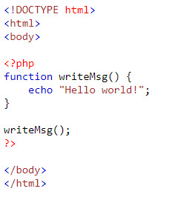
PHP Functions
Note: A function name can start with a letter or underscore (not a number).
Example

Slide 5
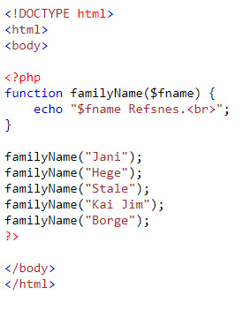
Function Arguments
Information can be passed to functions through arguments. An argument is just like a variable.
Arguments are specified after the function name, inside the parentheses. You can add as many arguments as you want, just separate them with a comma.
Example

Slide 6
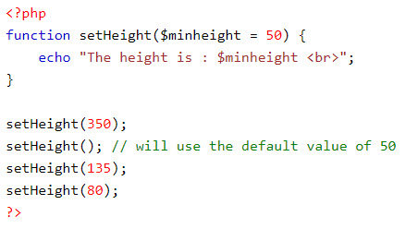
Default Argument Value
Example

Slide 7
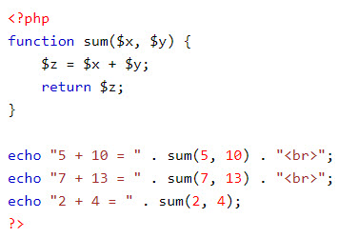
Returning values
To let a function return a value, use the return statement

Slide 8
Demo
Teacher demo about creating functions for students

Slide 9
Exception Handling
Exception handling is used to change the normal flow of the code execution if a specified error (exceptional) condition occurs. This condition is called an exception.
This is what normally happens when an exception is triggered:
The current code state is saved
The code execution will switch to a predefined (custom) exception handler function
Depending on the situation, the handler may then resume the execution from the saved code state, terminate the script execution or continue the script from a different location in the code
Note: Exceptions should only be used with error conditions, and should not be used to jump to another place in the code at a specified point.

Slide 10
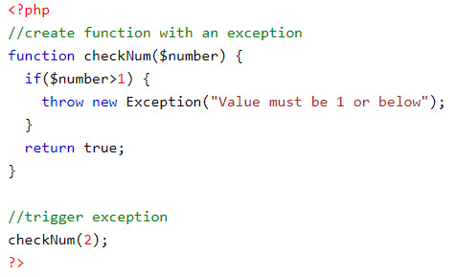
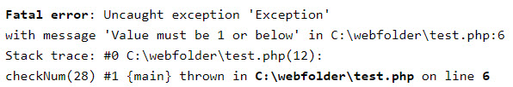
Use of Exceptions
When an exception is thrown, the code following it will not be executed, and PHP will try to find the matching "catch" block.
If an exception is not caught, a fatal error will be issued with an "Uncaught Exception" message.
Example:
Output:

Slide 11
Exception Handling
Try, throw and catch
try - A function using an exception should be in a "try" block. If the exception does not trigger, the code will continue as normal. However if the exception triggers, an exception is "thrown"
throw - This is how you trigger an exception. Each "throw" must have at least one "catch"
catch - A "catch" block retrieves an exception and creates an object containing the exception information

Slide 12
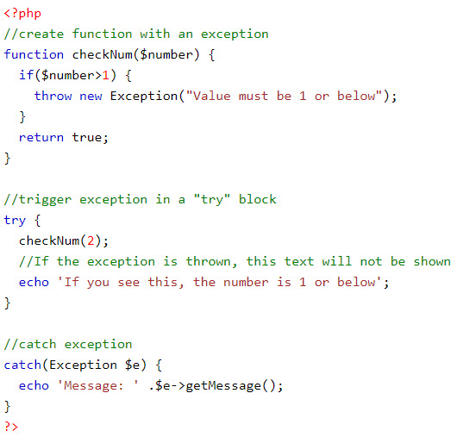

Exception Handling
Example
Output:

Slide 13
Exception Handling
Example explained:
The code above throws an exception and catches it:
The checkNum() function is created. It checks if a number is greater than 1. If it is, an exception is thrown
The checkNum() function is called in a "try" block
The exception within the checkNum() function is thrown
The "catch" block retrieves the exception and creates an object ($e) containing the exception information
The error message from the exception is echoed by calling $e->getMessage() from the exception object

Slide 14
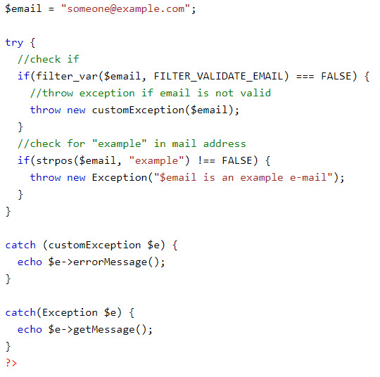
Multiple Exceptions
It is possible for a script to use multiple exceptions to check for multiple conditions.
It is possible to use several if..else blocks, a switch, or nest multiple exceptions. These exceptions can use different exception classes and return different error messages
Example:

Slide 15
Exception Handling
Rules for exceptions
Code may be surrounded in a try block, to help catch potential exceptions
Each try block or "throw" must have at least one corresponding catch block
Multiple catch blocks can be used to catch different classes of exceptions
Exceptions can be thrown (or re-thrown) in a catch block within a try block

Slide 16
Re-throwing Exceptions
Sometimes, when an exception is thrown, you may wish to handle it differently than the standard way. It is possible to throw an exception a second time within a "catch" block.
A script should hide system errors from users. System errors may be important for the coder, but are of no interest to the user.
To make things easier for the user you can re-throw the exception with a user friendly message

Slide 17
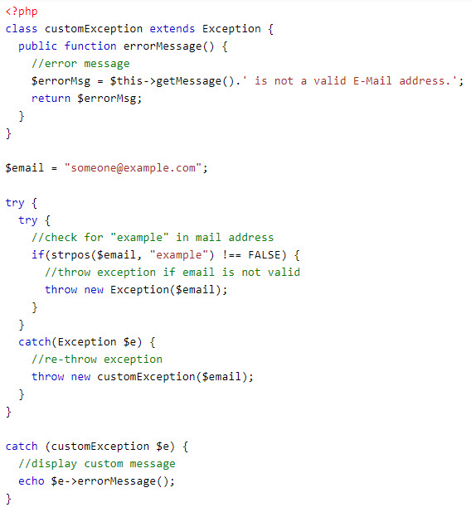
Re-throwing Exceptions

Slide 18
Re-throwing Exceptions
Example explained:
The code above tests if the email-address contains the string "example" in it, if it does, the exception is re-thrown:
The customException() class is created as an extension of the old exception class. This way it inherits all methods and properties from the old exception class
The errorMessage() function is created. This function returns an error message if an e-mail address is invalid
The $email variable is set to a string that is a valid e-mail address, but contains the string "example"
The "try" block contains another "try" block to make it possible to re-throw the exception
The exception is triggered since the e-mail contains the string "example"
The "catch" block catches the exception and re-throws a "customException"
The "customException" is caught and displays an error message
If the exception is not caught in its current "try" block, it will search for a catch block on "higher levels".

Slide 19
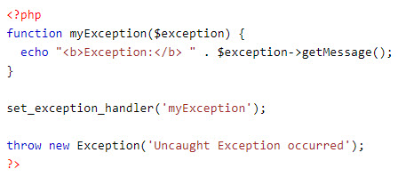
Set a Top Level Exception Handler
The set_exception_handler() function sets a user-defined function to handle all uncaught exceptions
Output:

Slide 20
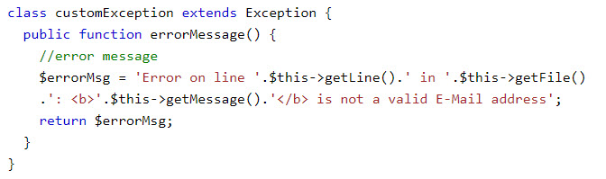
Custom Exception Class
To create a custom exception handler you must create a special class with functions that can be called when an exception occurs in PHP. The class must be an extension of the exception class.
The custom exception class inherits the properties from PHP's exception class and you can add custom functions to it.
Example

Slide 21
Demo
Teacher demo code about exception handling for students.

Slide 22
Summary
Creating and calling functions in PHP
Exception handling in PHP

